Slide 1
Water, temperature and climate change
From Stefani Panova and
Elizabeth Ilieva, Bulgaria

Slide 2
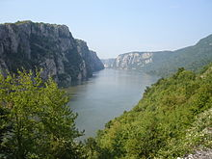
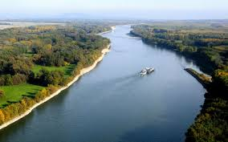
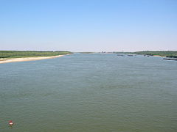
Water in Bulgaria
540 rivers
Danube river
Black Sea

Slide 3
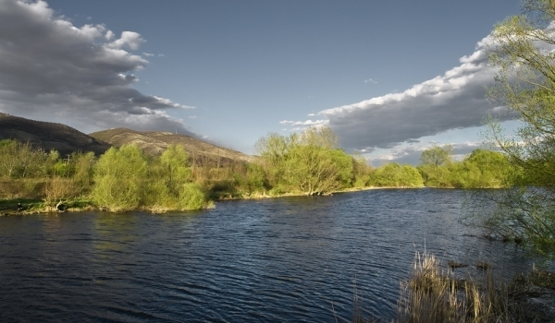
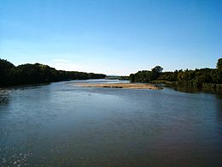
Rivers in Bulgaria
Iskar River - length of 368 km.
Tundzha River-length of 350 km.
Maritsa River-length of 321,6 km.

Slide 4
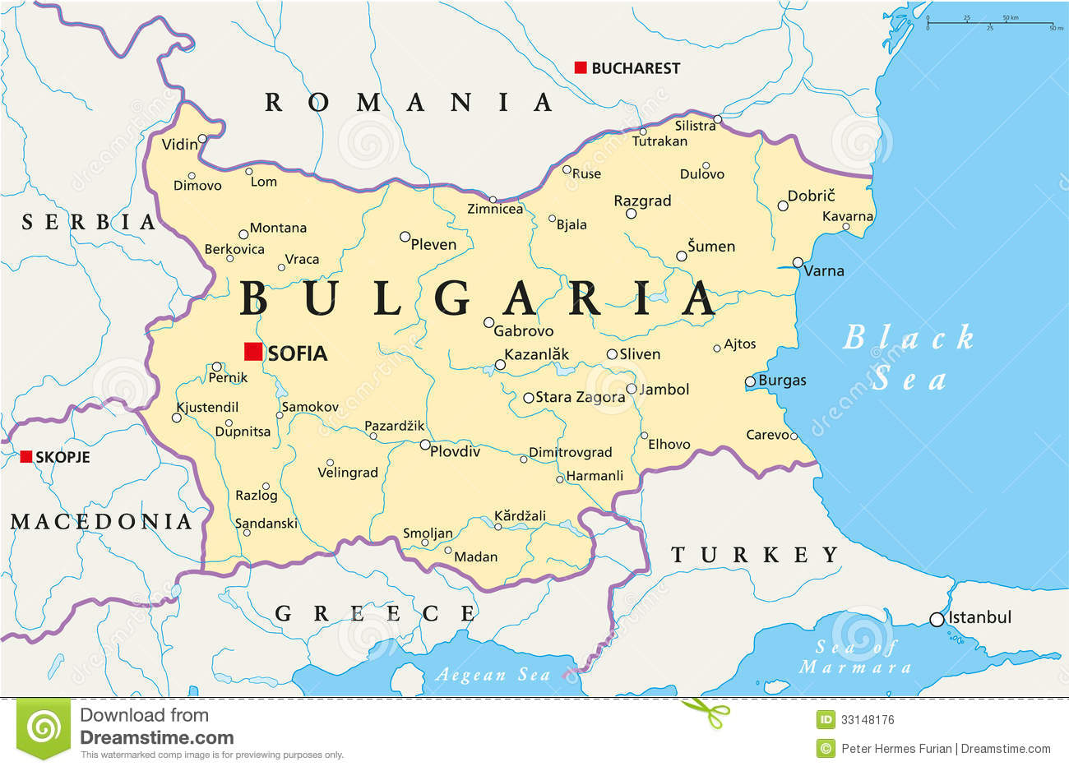

Slide 5
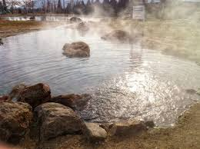
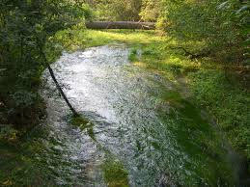
Thermal springs
Bulgaria has more than 225 deposits of mineral springs.
Rupite - 71 degrees. The water is medicinal.

Slide 6
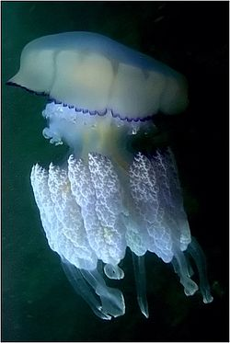
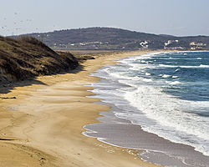
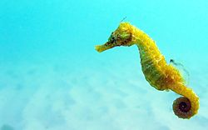
Black Sea
-transparency of sea water reaches 30 m
-Summer sea water along the coast is warmed to 24-28 ° C.

Slide 7
Climate regions in Bulgaria
Climate regions in Bulgaria are divided into five areas: area with a temperate continental climate, transient area with continental climate, transient area with a Mediterranean climate, Area of the Black Sea climatic influence, Mountain climatic region.

Slide 8
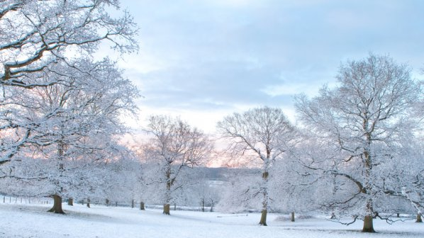
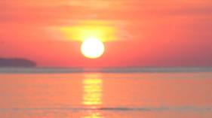
Temperature
The highest temperature measured in Bulgaria Sadovo - 45.2 degrees. The lowest temperature measured in Tran- -38,3 in 1947.

Slide 9
Climate change in Bulgaria – Research

Slide 10
Year | Sum of precipitation | Periods with no precipitation?
2005 | 675.8 | 17
2006 | 616.8 | 22
2007 | 727.4 | 42
2008 | 356.1 | 45
2009 | 493.5 | 25
2010 | 672.5 | 27
2011 | 379 | 21
2012 | 485.5 | 23
2013 | 428 | 44
2014 | 584 | 21

Slide 11
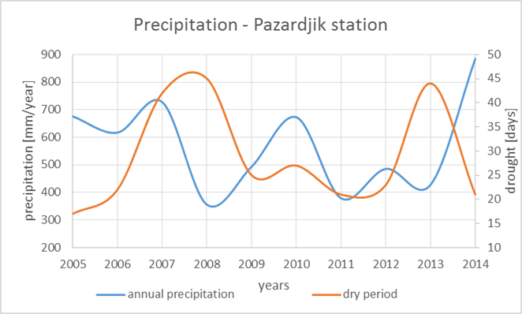
Annual precipitation and dry period

Slide 12
Tornadoes
The space distribution of the location of all known tornadoes and waterspouts is shown on this picture.

Slide 14
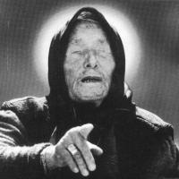
Interesting fact for Vanga
Vanga falls at the epicenter of the storm picked up and carried away by the tornado two kilometers. Her eyes fall sand, which threatens her with blindness. Since then she received her strong.

Slide 15
Thank you for your attention ☺

